Slide 1
Relational Algebra

Slide 2
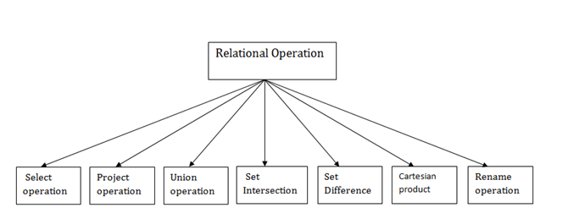
Relational algebra is a procedural query language. It gives a step by step process to obtain the result of the query. It uses operators to perform queries.

Slide 3
Select operation
The select operation selects tuples that satisfy a given predicate.
It is denoted by sigma (σ).
Notation: σ p(r)
(Where:
σ is used for selection prediction r is used for relation p is used as a propositional logic formula which may use connectors like: AND OR and NOT. These relational can use as relational operators like =, ≠, ≥, <, >, ≤.
)

Slide 4
Example of Select operation
σ BRANCH_NAME=“kota_MN1" (LOAN)
Show table with all attributes satisfying condition

Slide 5
2. Project Operation:
This operation shows the list of those attributes that we wish to appear in the result. Rest of the attributes are eliminated from the table. It is denoted by ∏.
Notation: ∏ A1, A2, An (r)
(Where
A1, A2, A3 is used as an attribute name of relation r.
)

Slide 6
Example
Customer_Loan(Name, street, city, loan_id,Cus_id)
∏ NAME, CITY (CUSTOMER)

Slide 7
Union
Suppose there are two tuples R and S. The union operation contains all the tuples that are either in R or S or both in R & S.
It eliminates the duplicate tuples. It is denoted by ∪.
Notation: R ∪ S
Condition:
R and S must have the attribute of the same number.
Duplicate tuples are eliminated automatically.

Slide 8
Example
Customer_deposit( CUST_NAME , address,account_no)
Customer_loan( CUST_NAME ,address, loan_no)
∏ CUSTOMER_NAME (Customer_deposit) ∪ ∏ CUST_NAME (Customer_loan)

Slide 9
Set-Intersection
Suppose there are two tuples R and S. The set intersection operation contains all tuples that are in both R & S.
It is denoted by intersection ∩.
Notation: R ∩ S

Slide 10
∏ CUSTOMER_NAME (Customer_deposit) ∩ ∏ CUST_NAME (Customer_loan)

Slide 11
Set Difference:
Suppose there are two tuples R and S. The set intersection operation contains all tuples that are in R but not in S. It is denoted by intersection minus (-).
Notation: R - S

Slide 12
∏ CUSTOMER_NAME (Customer_deposit) ∏ CUST_NAME (Customer_loan)

Slide 13
Cartesian product
The Cartesian product is used to combine each row in one table with each row in the other table. It is also known as a cross product.
It is denoted by X.
Notation: E X D

Slide 14
EMPLOYEE (EMP_id, Name, dept)
DEPARTMENT (dept_id, dept_Name)
EMPLOYEE X DEPARTMENT

Slide 15
Rename
The rename operation is used to rename the output relation. It is denoted by rho (ρ).
Example: We can use the rename operator to rename STUDENT relation to STUDENT1.
Example: ρ(STUDENT1, STUDENT)

Slide 16
Join
A Join operation combines related tuples from different relations, if and only if a given join condition is satisfied. It is denoted by ⋈.

Slide 17
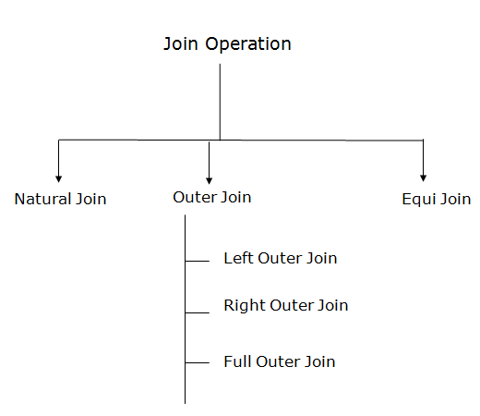

Slide 18
1. Natural Join:
A natural join is the set of tuples of all combinations in R and S that are equal on their common attribute names.
It is denoted by ⋈.
a. Left outer join:
Left outer join contains the set of tuples of all combinations in R and S that are equal on their common attribute names.
In the left outer join, tuples in R have no matching tuples in S.
It is denoted by ⟕.

Slide 19
b. Right outer join:
Right outer join contains the set of tuples of all combinations in R and S that are equal on their common attribute names.
In right outer join, tuples in S have no matching tuples in R.
It is denoted by ⟖.
c,. Full outer join:
Full outer join is like a left or right join except that it contains all rows from both tables.
In full outer join, tuples in R that have no matching tuples in S and tuples in S that have no matching tuples in R in their common attribute name.
It is denoted by ⟗.

Slide 20
3. Equi join:
It is also known as an inner join. It is the most common join. It is based on matched data as per the equality condition. The equi join uses the comparison operator(=).

